Slide 1
Welcome to the Experiment
Pres any key to continue.

Slide 2
Get ready…

Slide 3
+

Slide 4
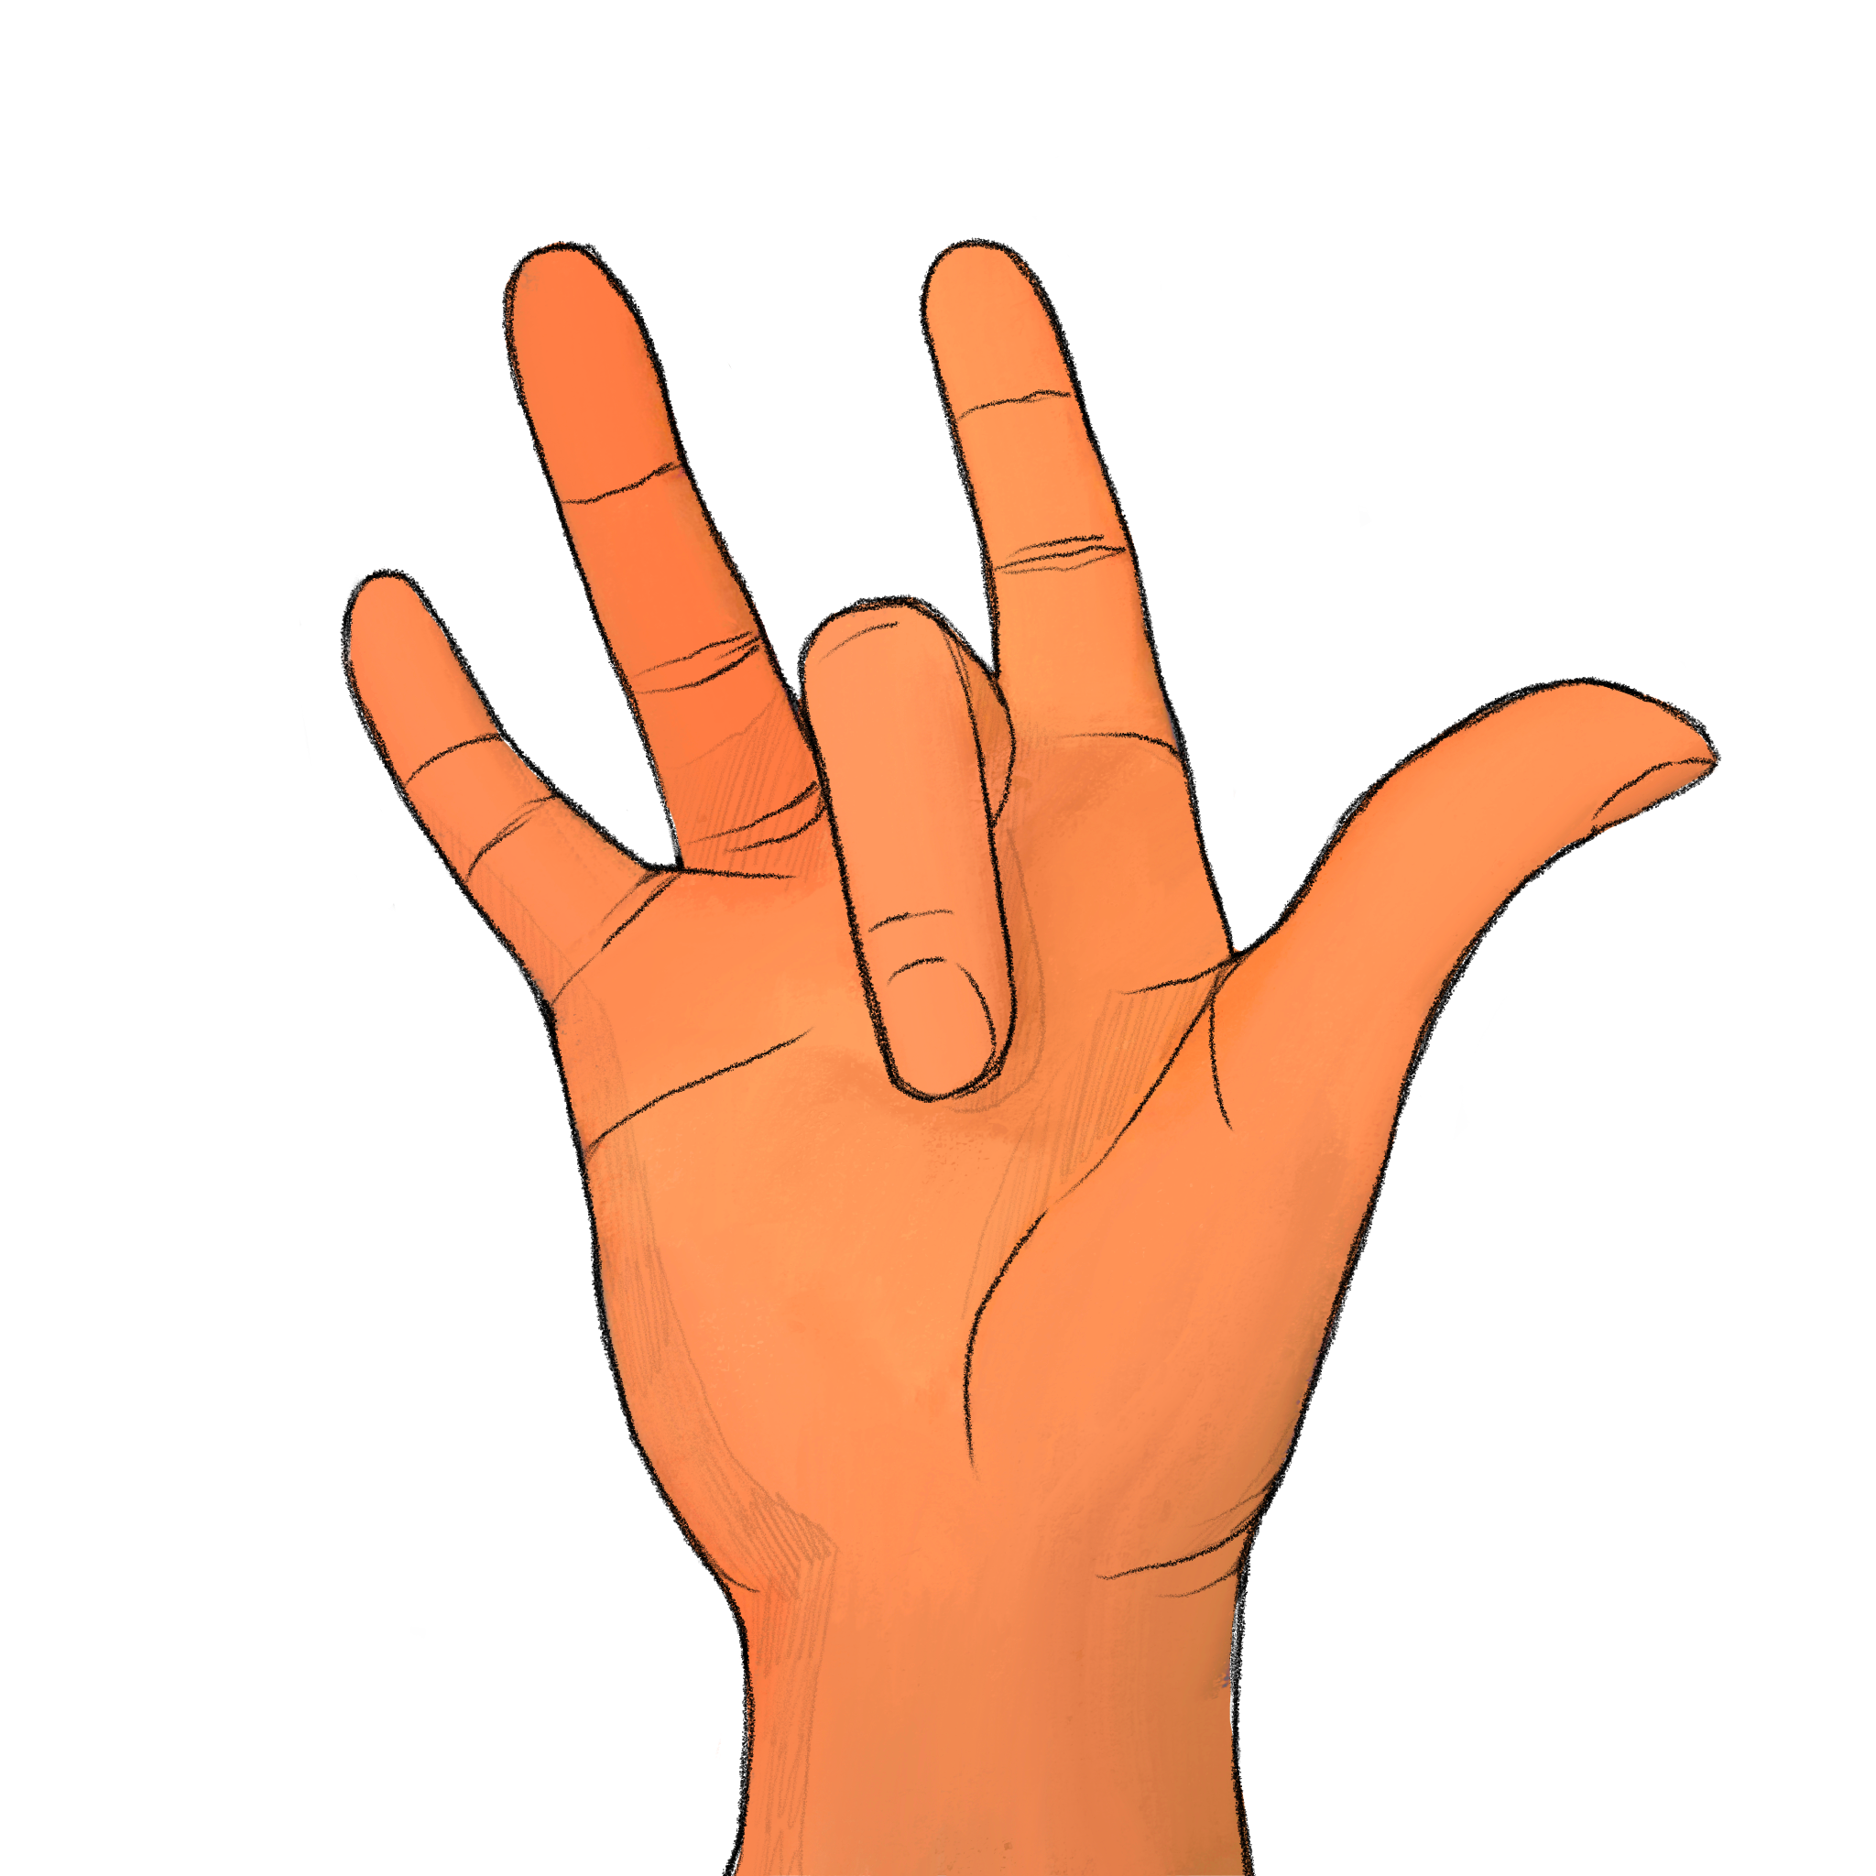
+

Slide 5
How many digits were raised? Experimenter, record the participant’s response if given before next slide transition; otherwise record a ’timeout’

Slide 6
How many digits were raised? Experimenter, record the participant’s response if given before next slide transition; otherwise record a ’timeout’

Slide 7
Get ready…

Slide 8
+

Slide 9
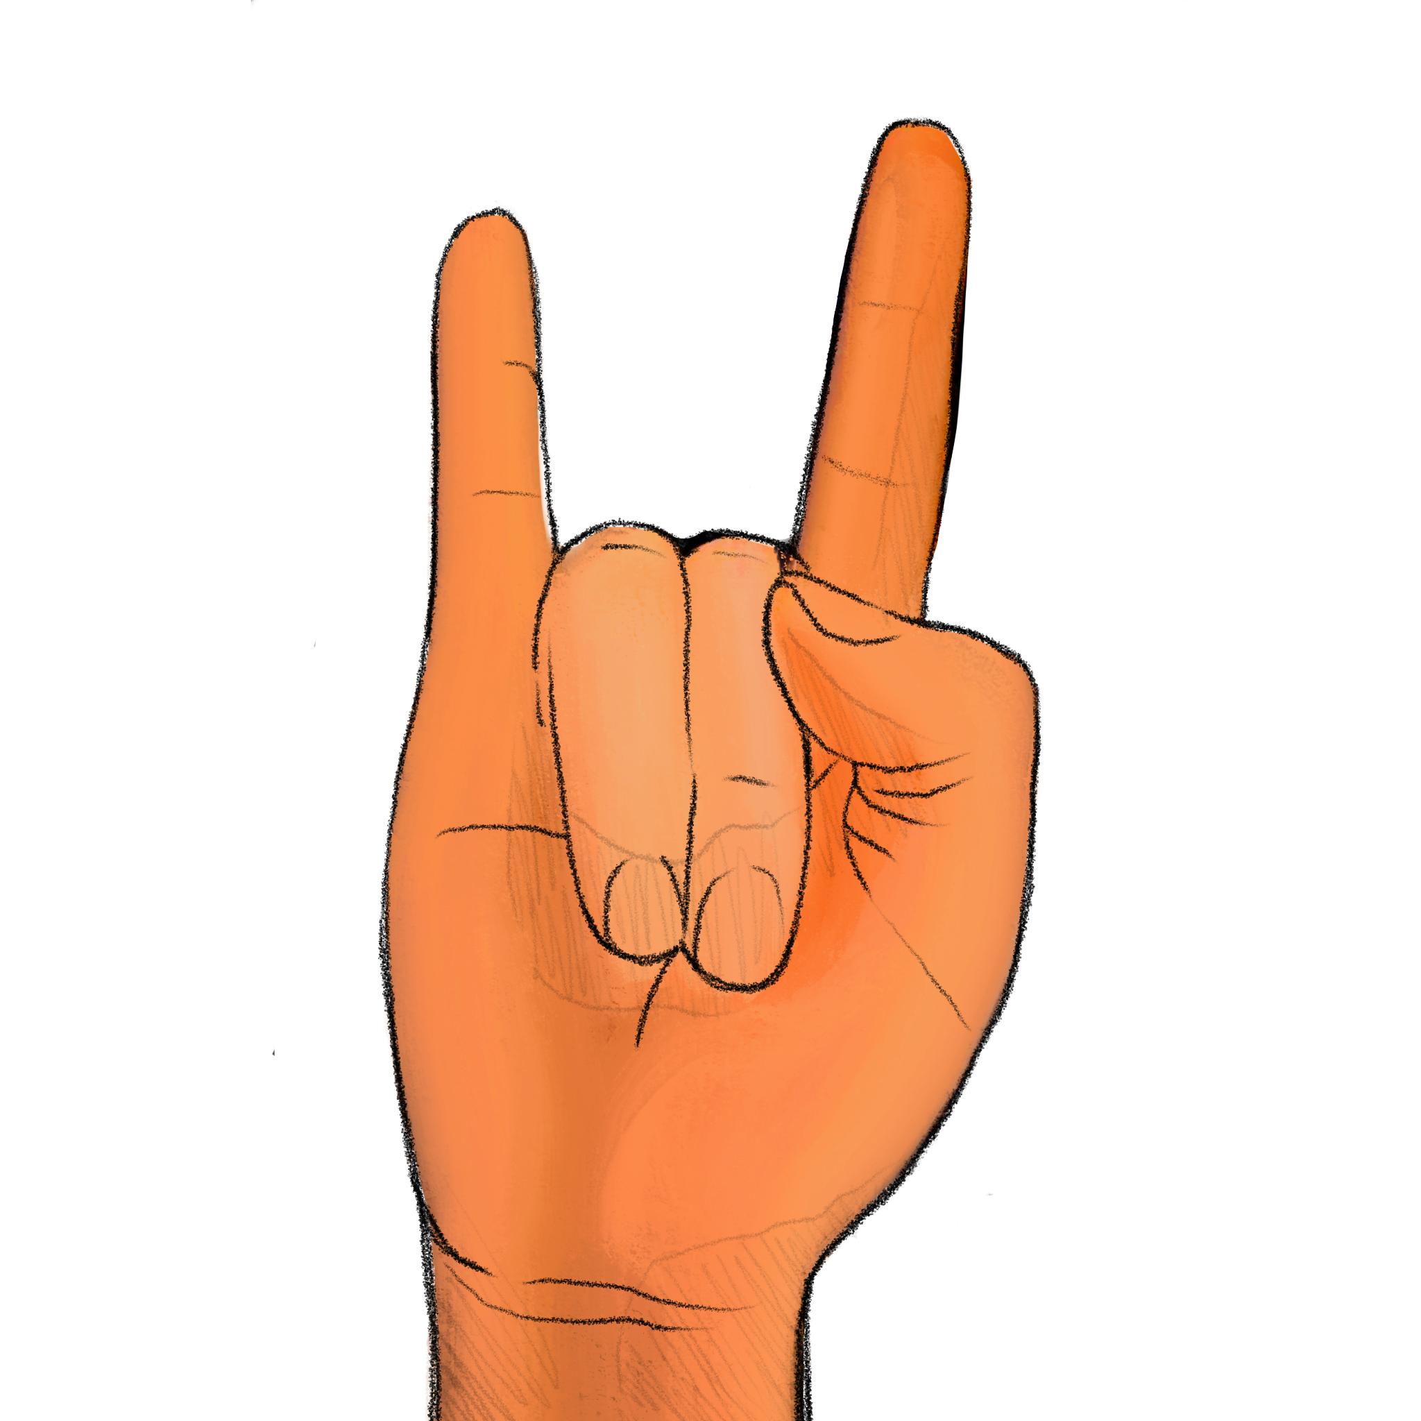
+

Slide 10
How many digits were raised? Experimenter, record the participant’s response if given before next slide transition; otherwise record a ’timeout’

Slide 11
Trial 3 Press any key to continue.

Slide 12
+

Slide 13
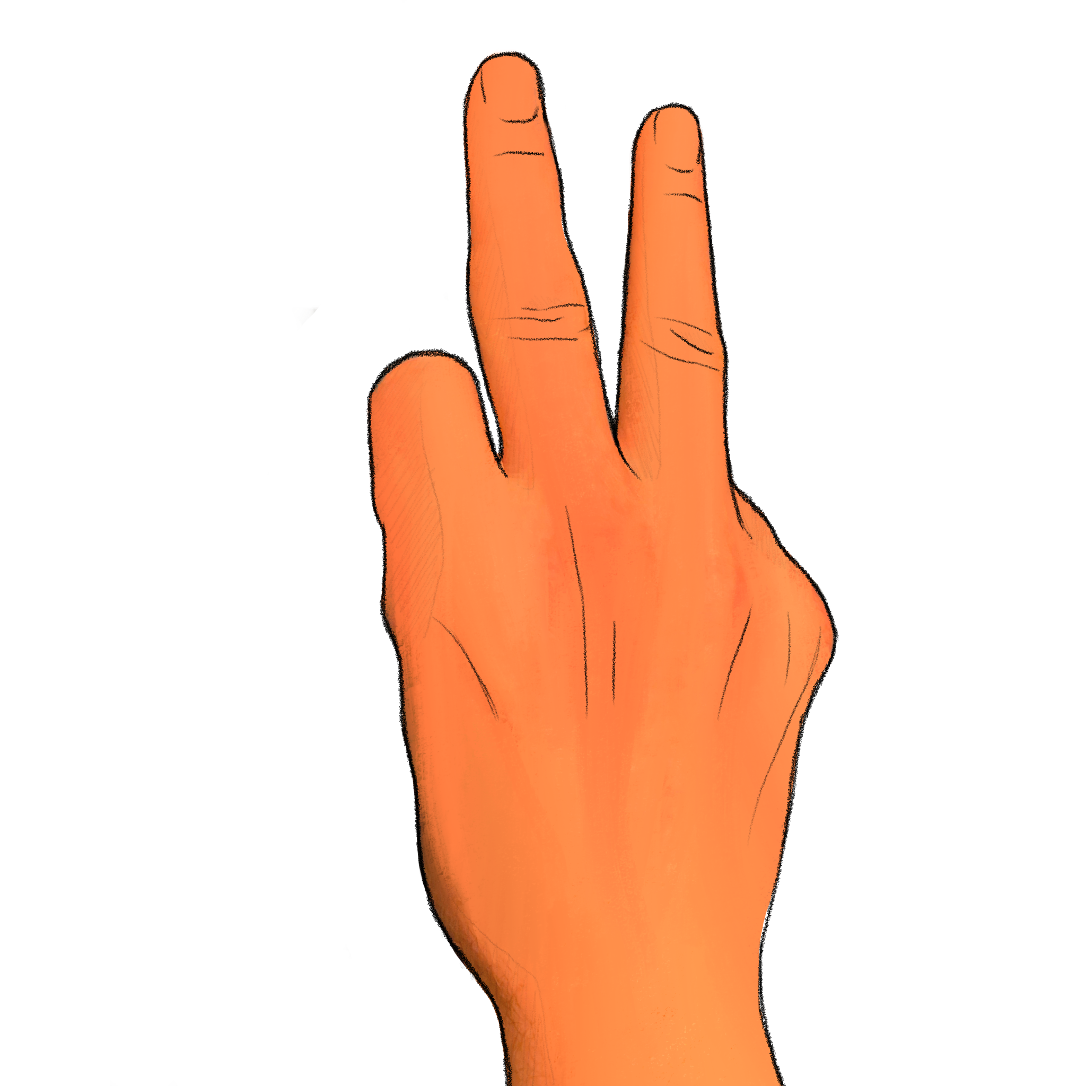
+

Slide 14
How many digits were raised? Experimenter, record the participant’s response if given before next slide transition; otherwise record a ’timeout’

Slide 15
Trial 4 Press any key to continue.

Slide 16
+

Slide 17
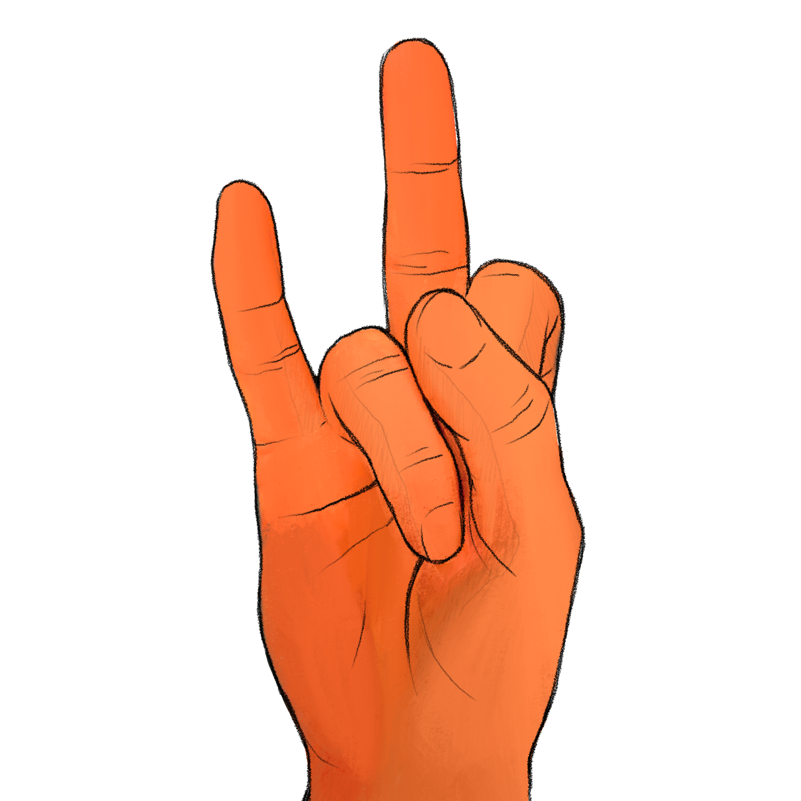
+

Slide 18
How many digits were raised? Experimenter, record the participant’s response if given before next slide transition; otherwise record a ’timeout’

Slide 19
Trial 5 Press any key to continue.

Slide 20
+

Slide 21
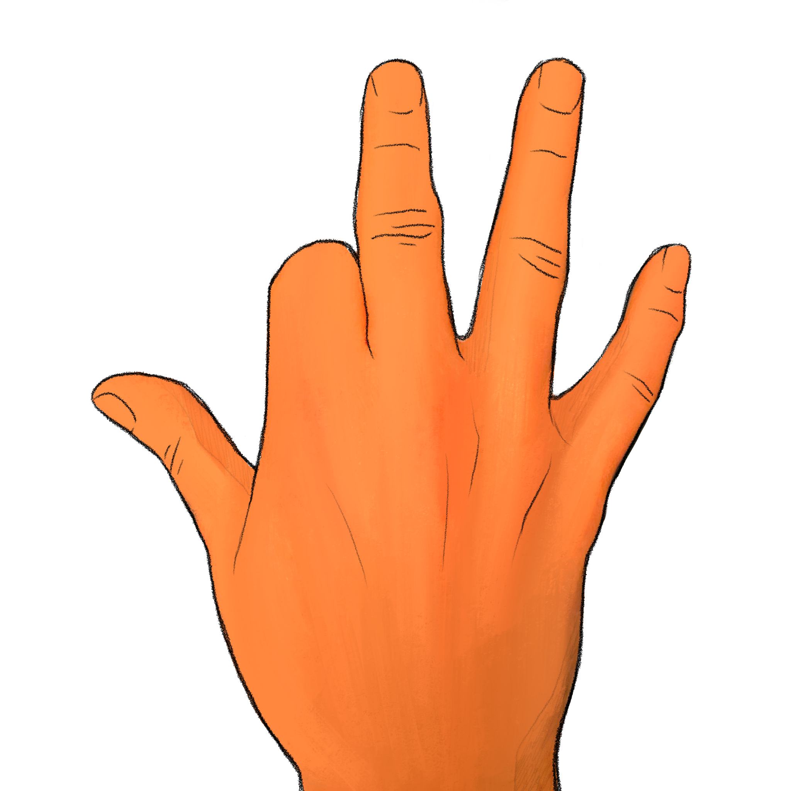
+

Slide 22
How many digits were raised? Experimenter, record the participant’s response if given before next slide transition; otherwise record a ’timeout’

Slide 23
Trial 6 Press any key to continue.

Slide 24
+

Slide 25
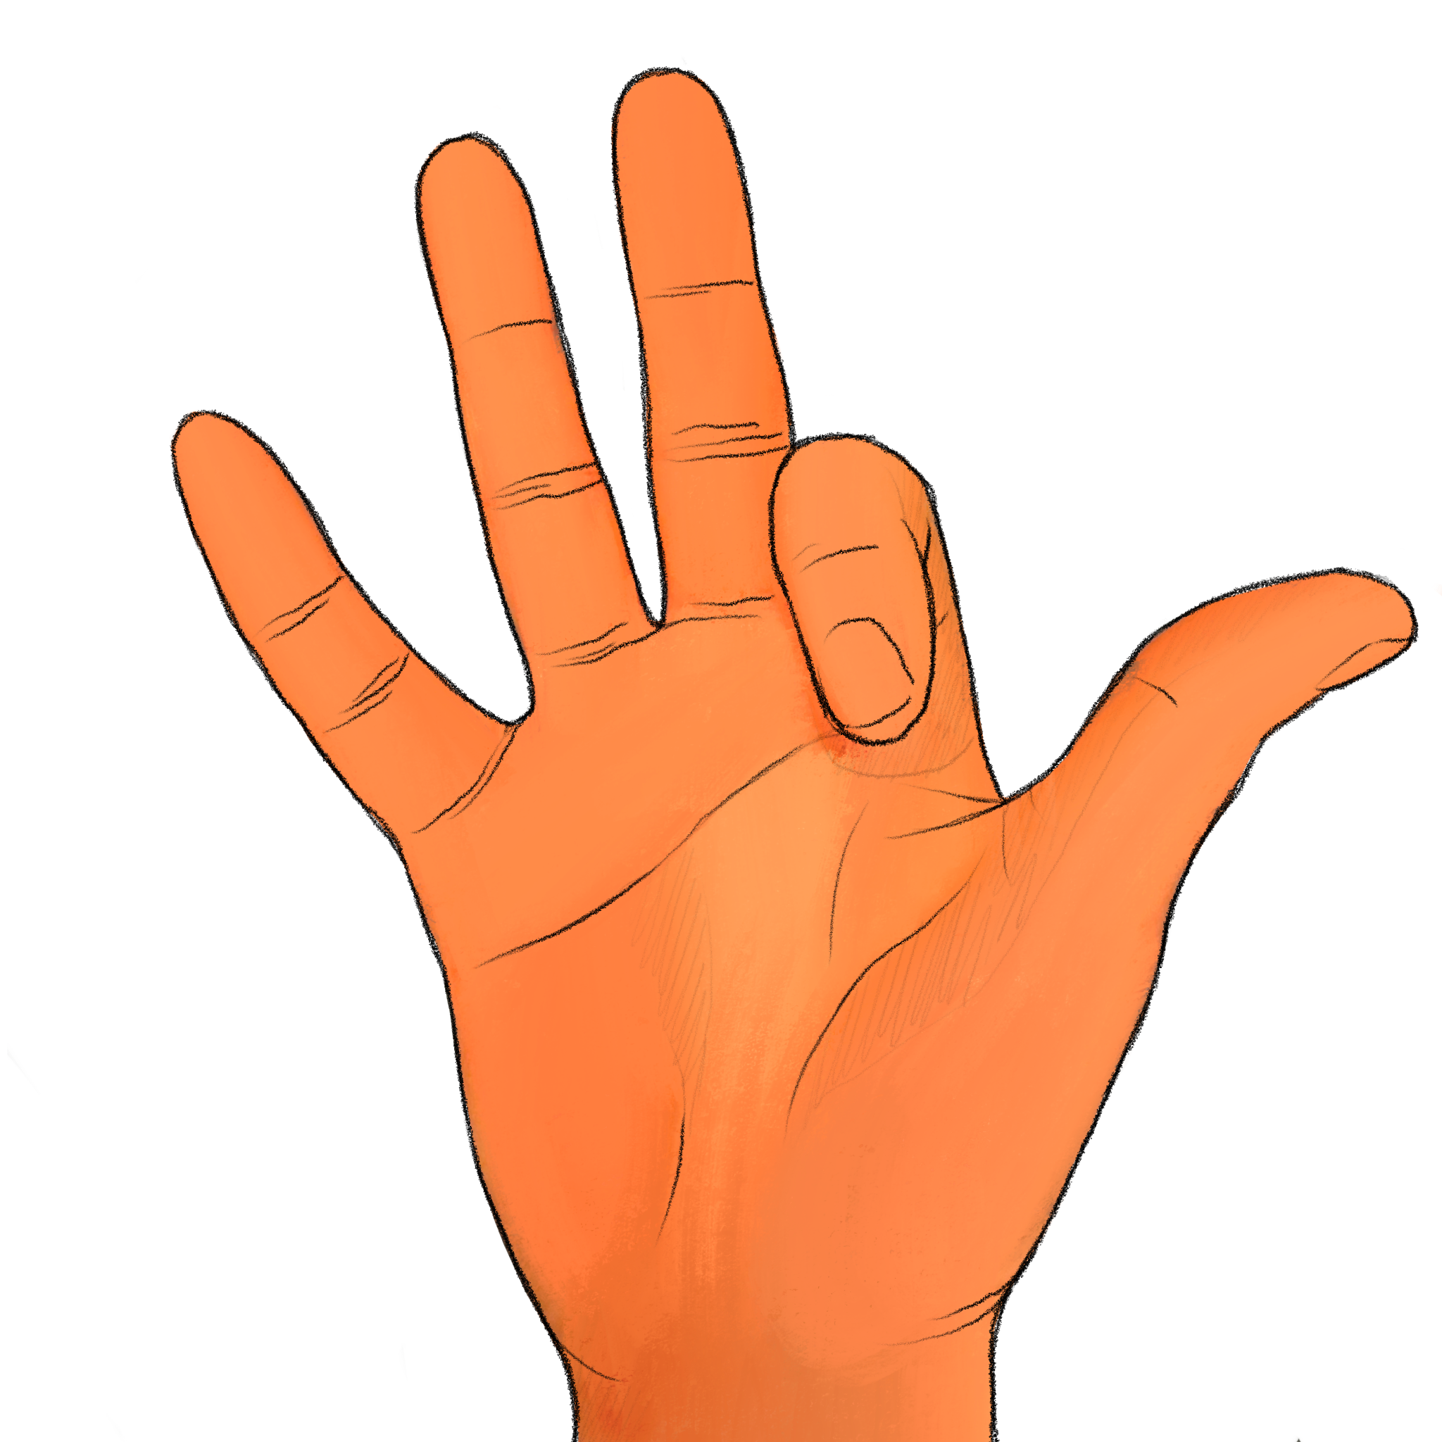
+

Slide 26
How many digits were raised? Experimenter, record the participant’s response if given before next slide transition; otherwise record a ’timeout’

Slide 27
Trial 7 Press any key to continue.

Slide 28
+

Slide 29
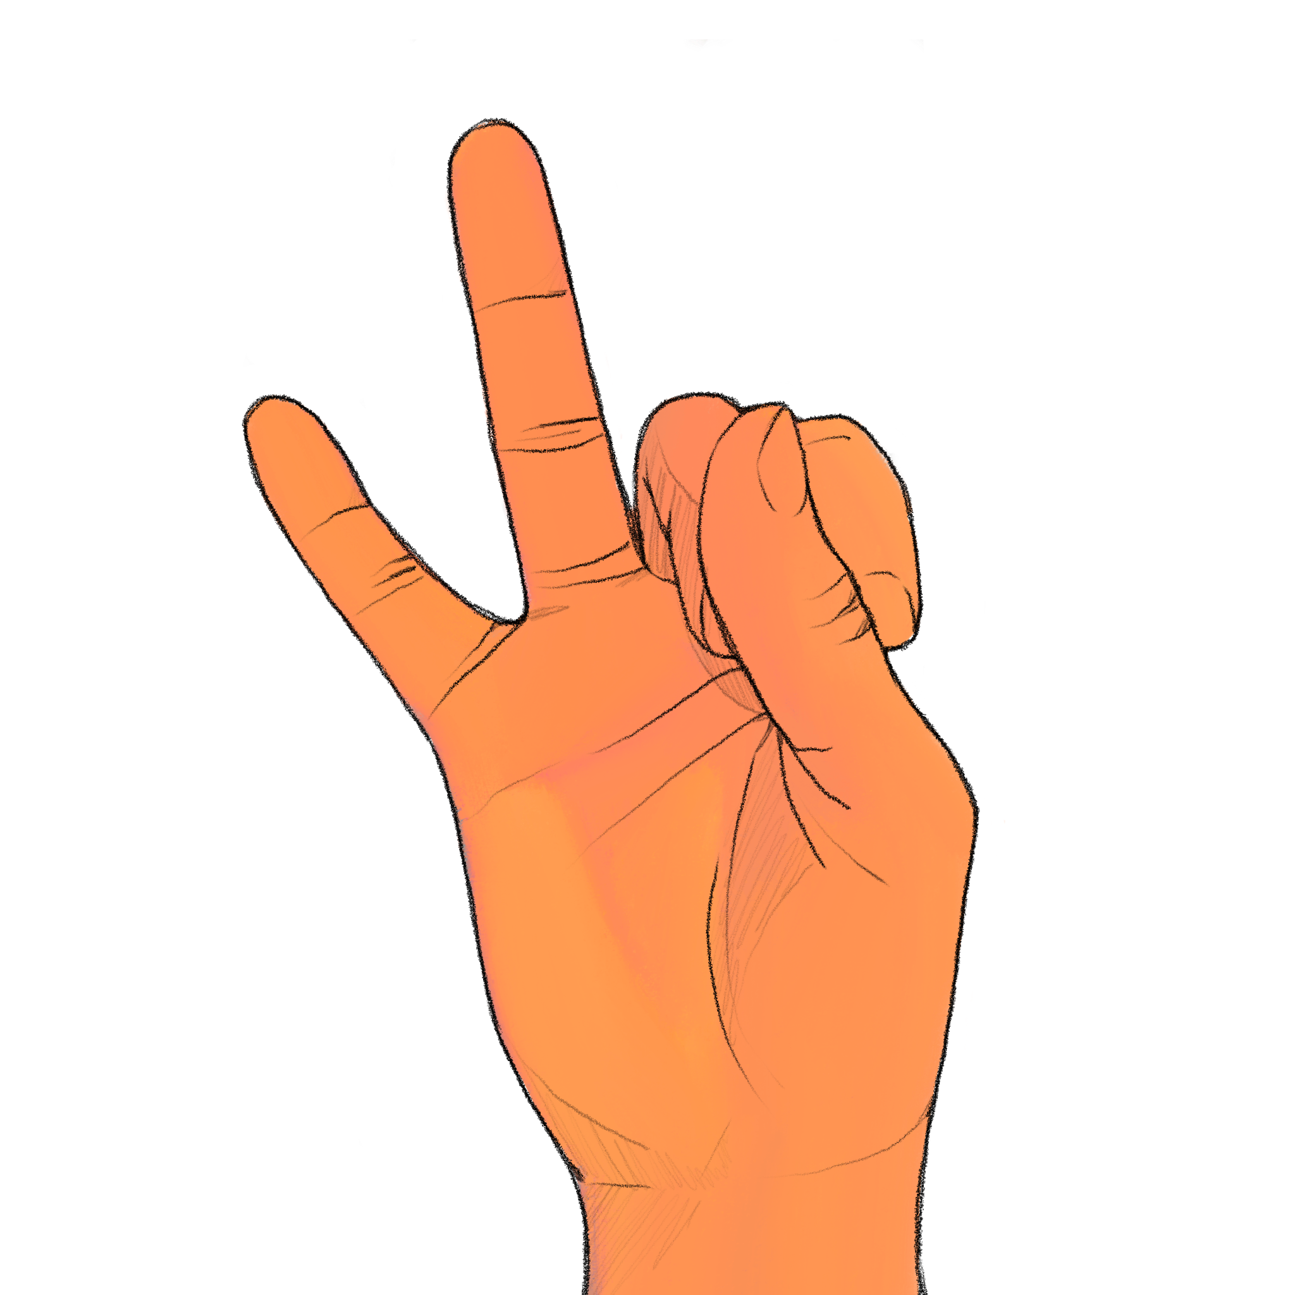
+

Slide 30
How many digits were raised? Experimenter, record the participant’s response if given before next slide transition; otherwise record a ’timeout’

Slide 31
Trial 8 Press any key to continue.

Slide 32
+

Slide 33
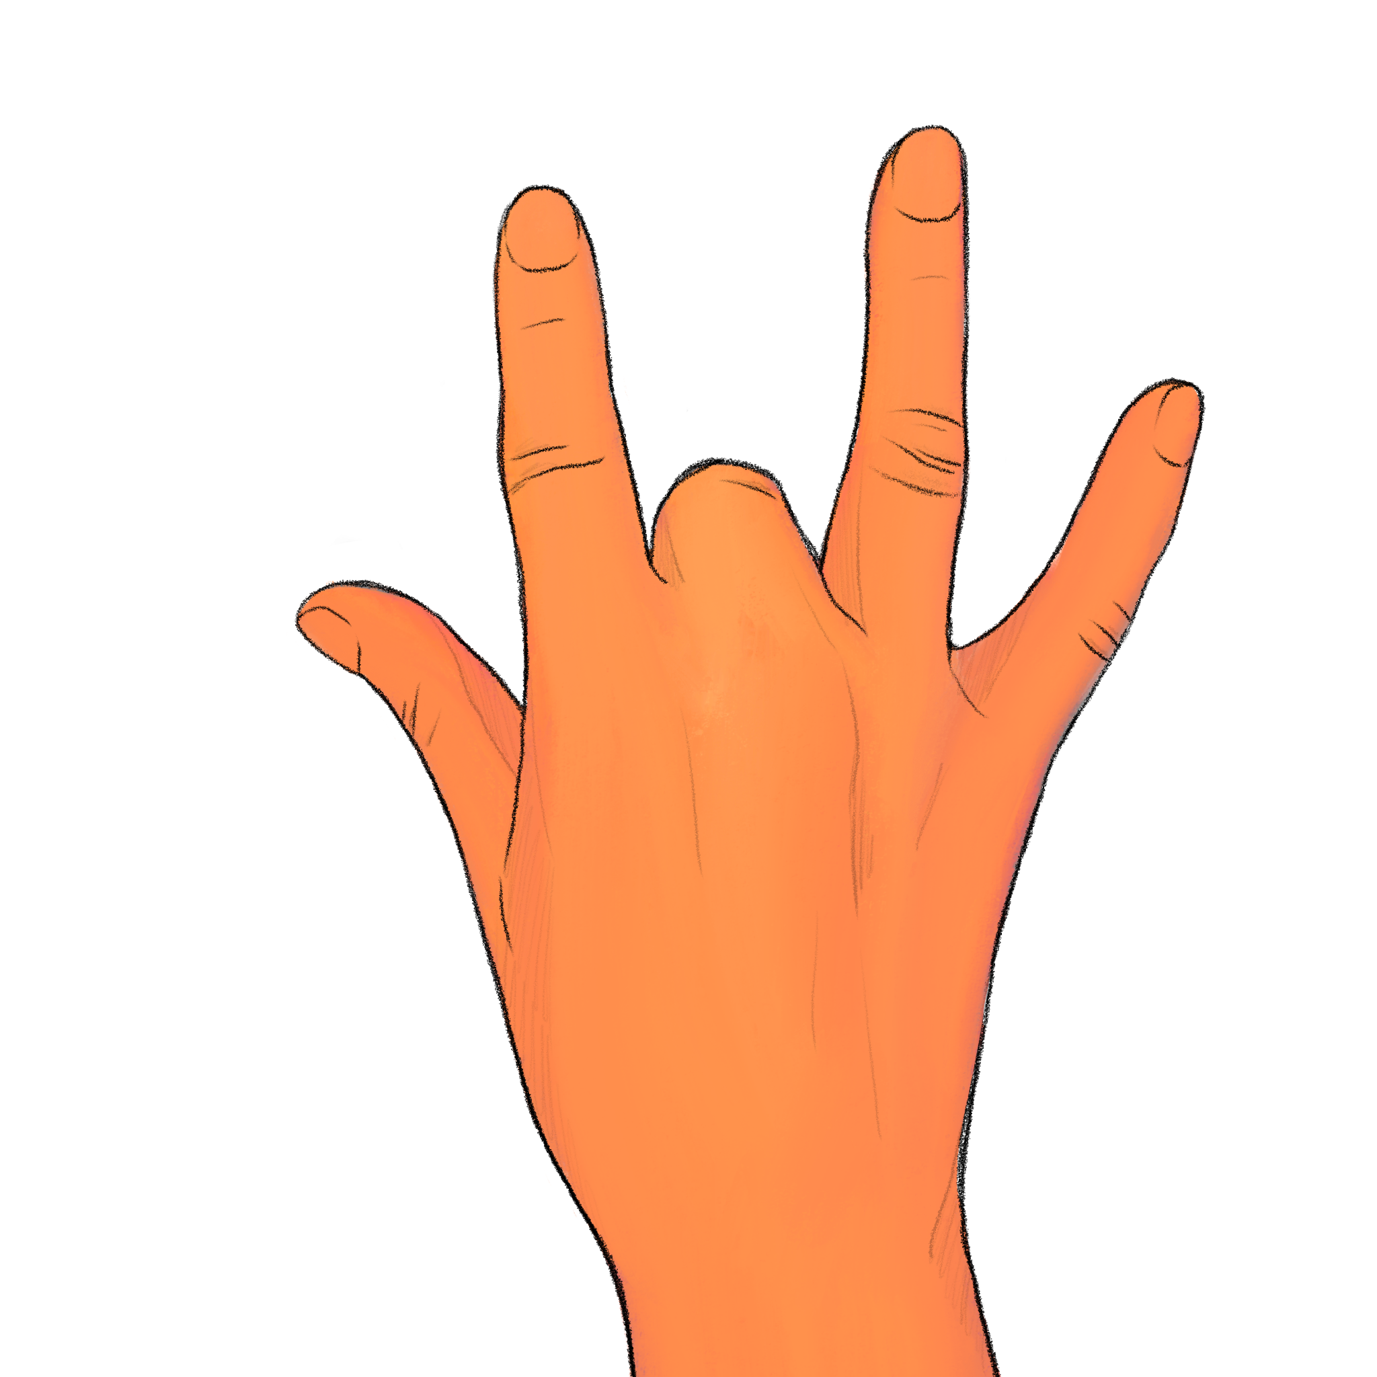
+

Slide 34
How many digits were raised? Experimenter, record the participant’s response if given before next slide transition; otherwise record a ’timeout’

Slide 35
Trial 9 Press any key to continue.

Slide 36
+

Slide 37
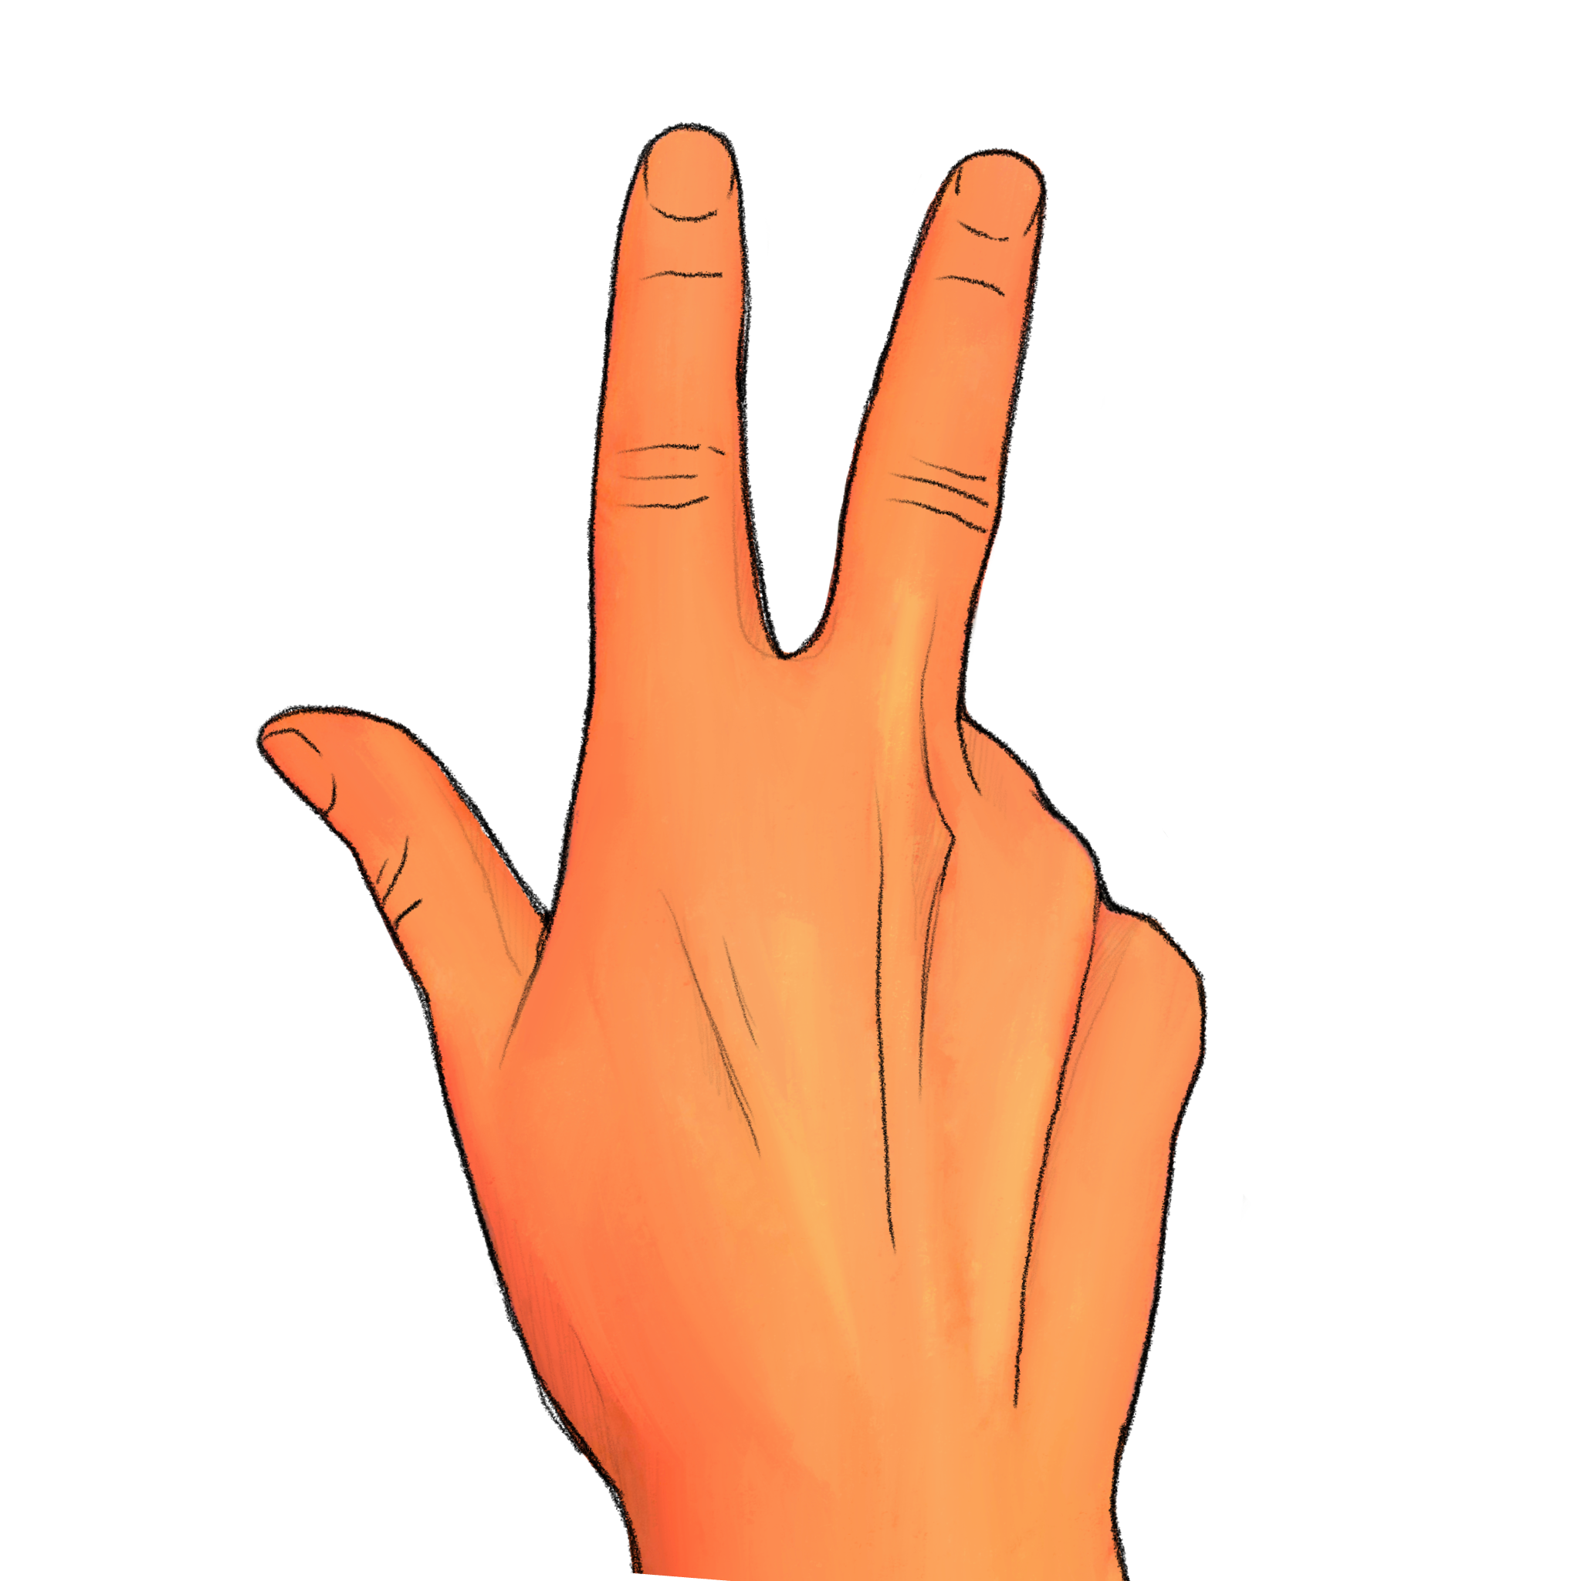
+

Slide 38
How many digits were raised? Experimenter, record the participant’s response if given before next slide transition; otherwise record a ’timeout’

Slide 39
Trial 10 Press any key to continue.

Slide 40
+

Slide 41
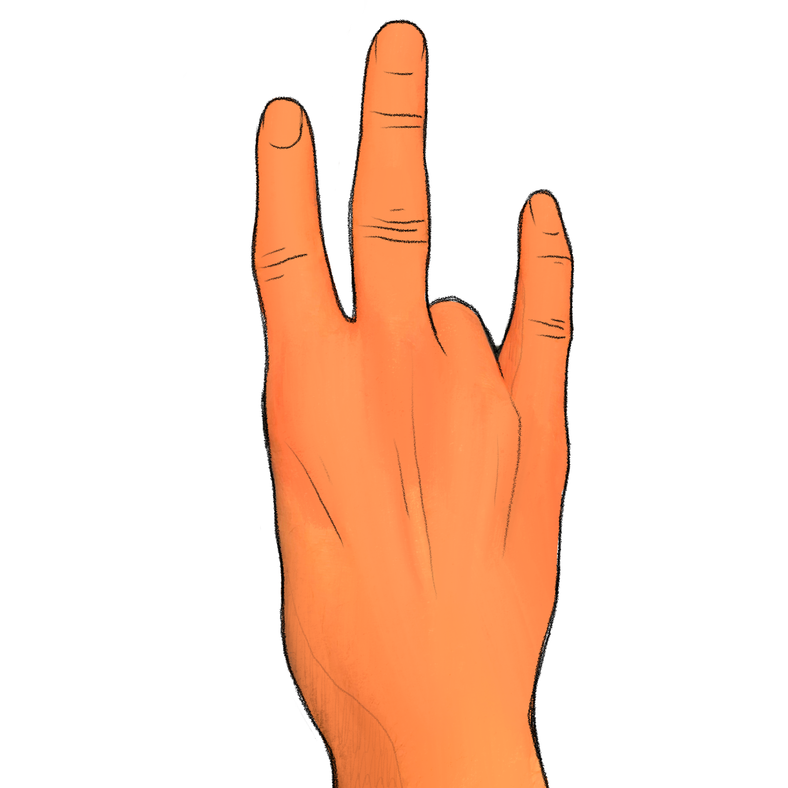
+

Slide 42
How many digits were raised? Experimenter, record the participant’s response if given before next slide transition; otherwise record a ’timeout’

Slide 43
Trial 11 Press any key to continue.

Slide 44
+

Slide 45
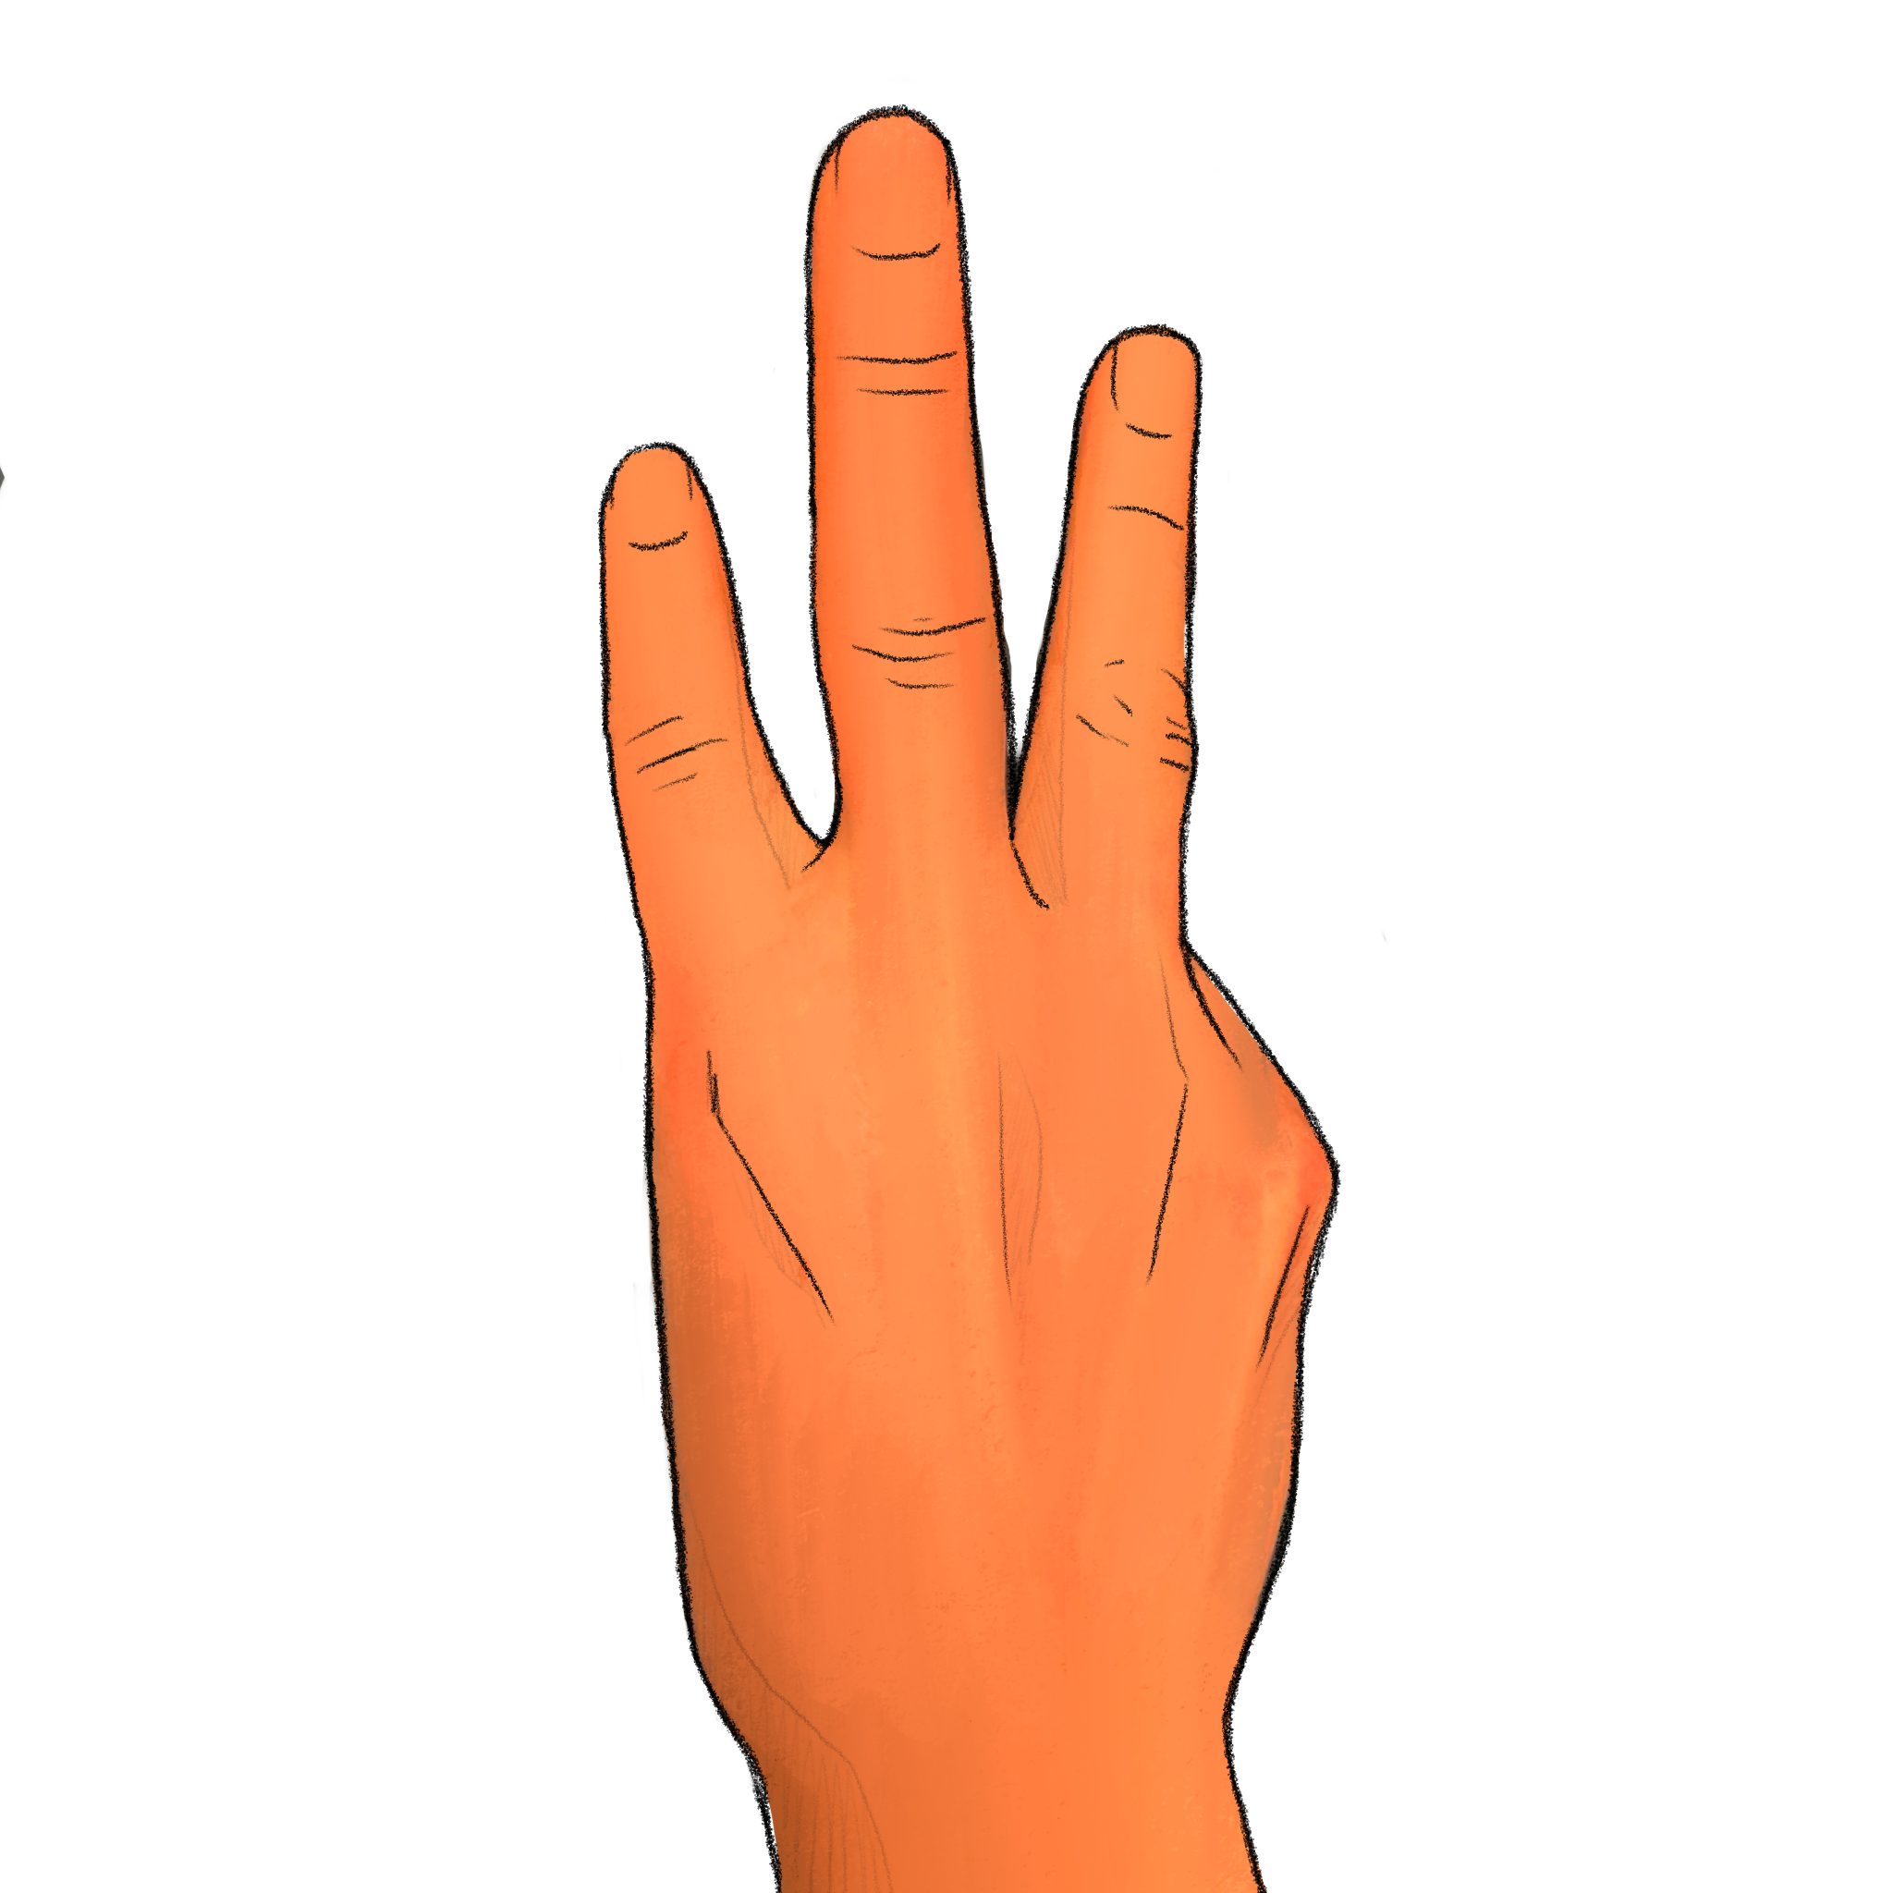
+

Slide 46
How many digits were raised? Experimenter, record the participant’s response if given before next slide transition; otherwise record a ’timeout’

Slide 47
Trial 12 Press any key to continue.

Slide 48
+

Slide 49
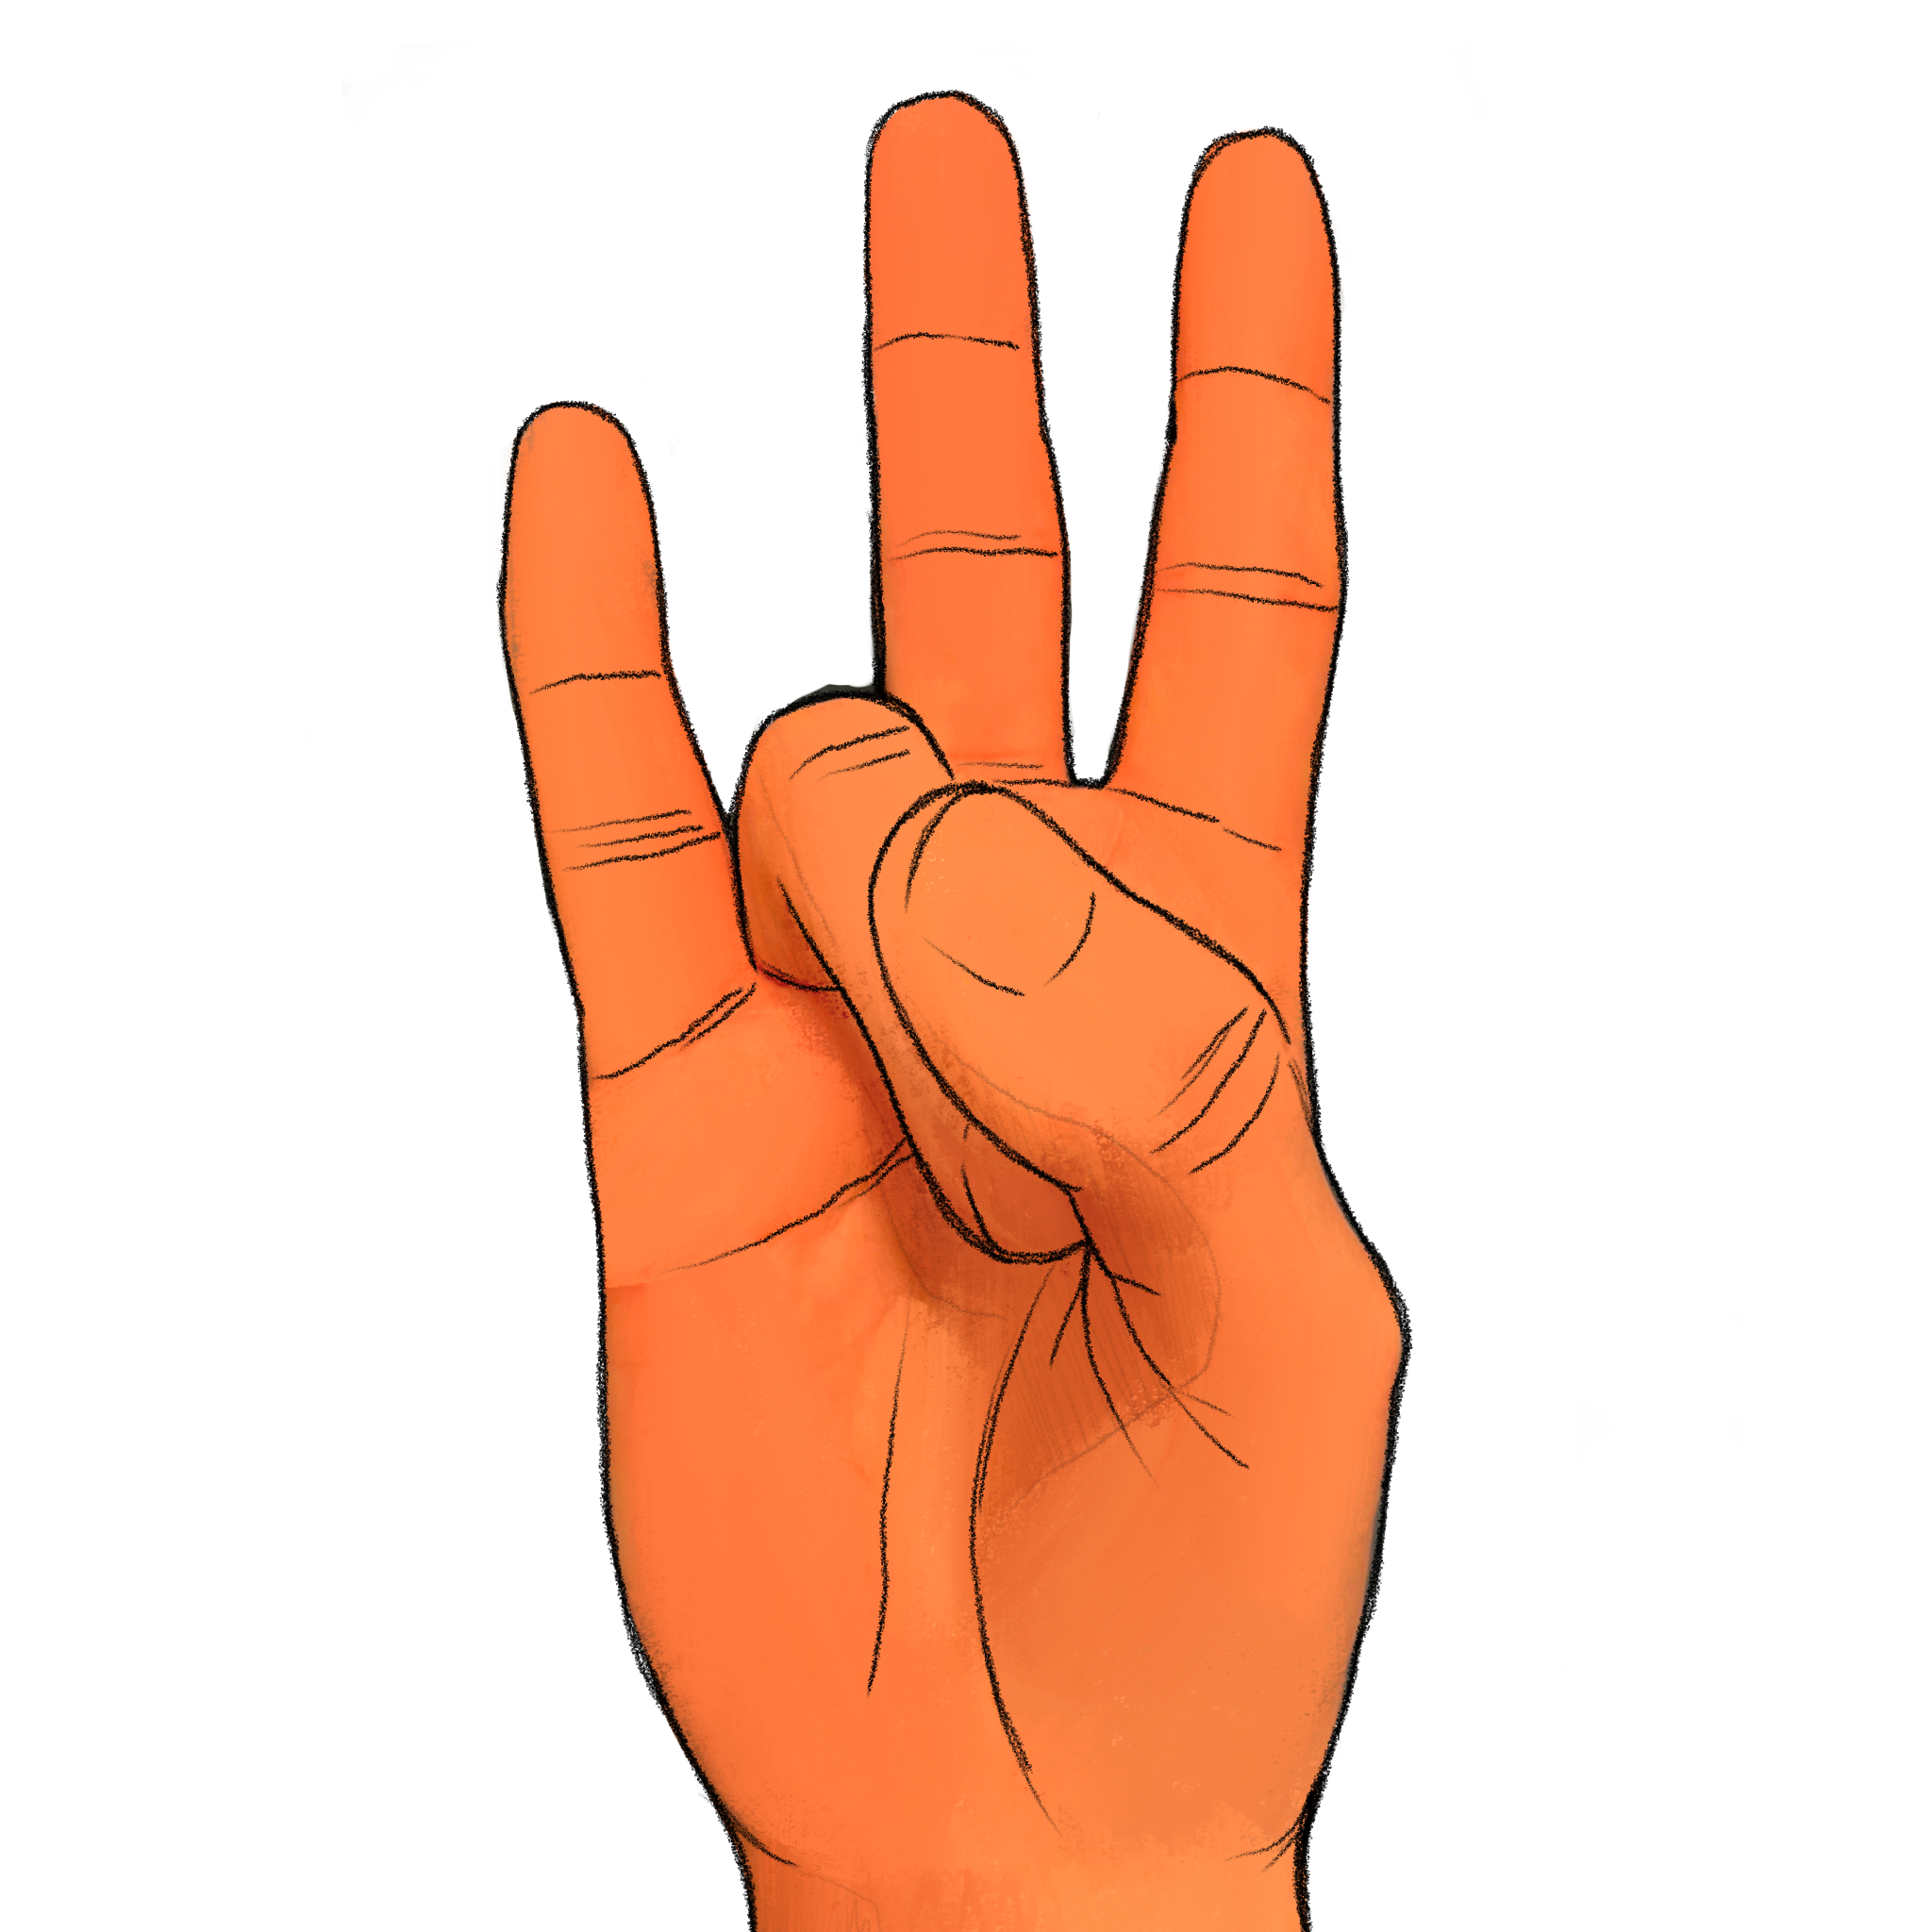
+

Slide 50
How many digits were raised? Experimenter, record the participant’s response if given before next slide transition; otherwise record a ’timeout’

Slide 51
Trial 13 Press any key to continue.

Slide 52
+

Slide 53
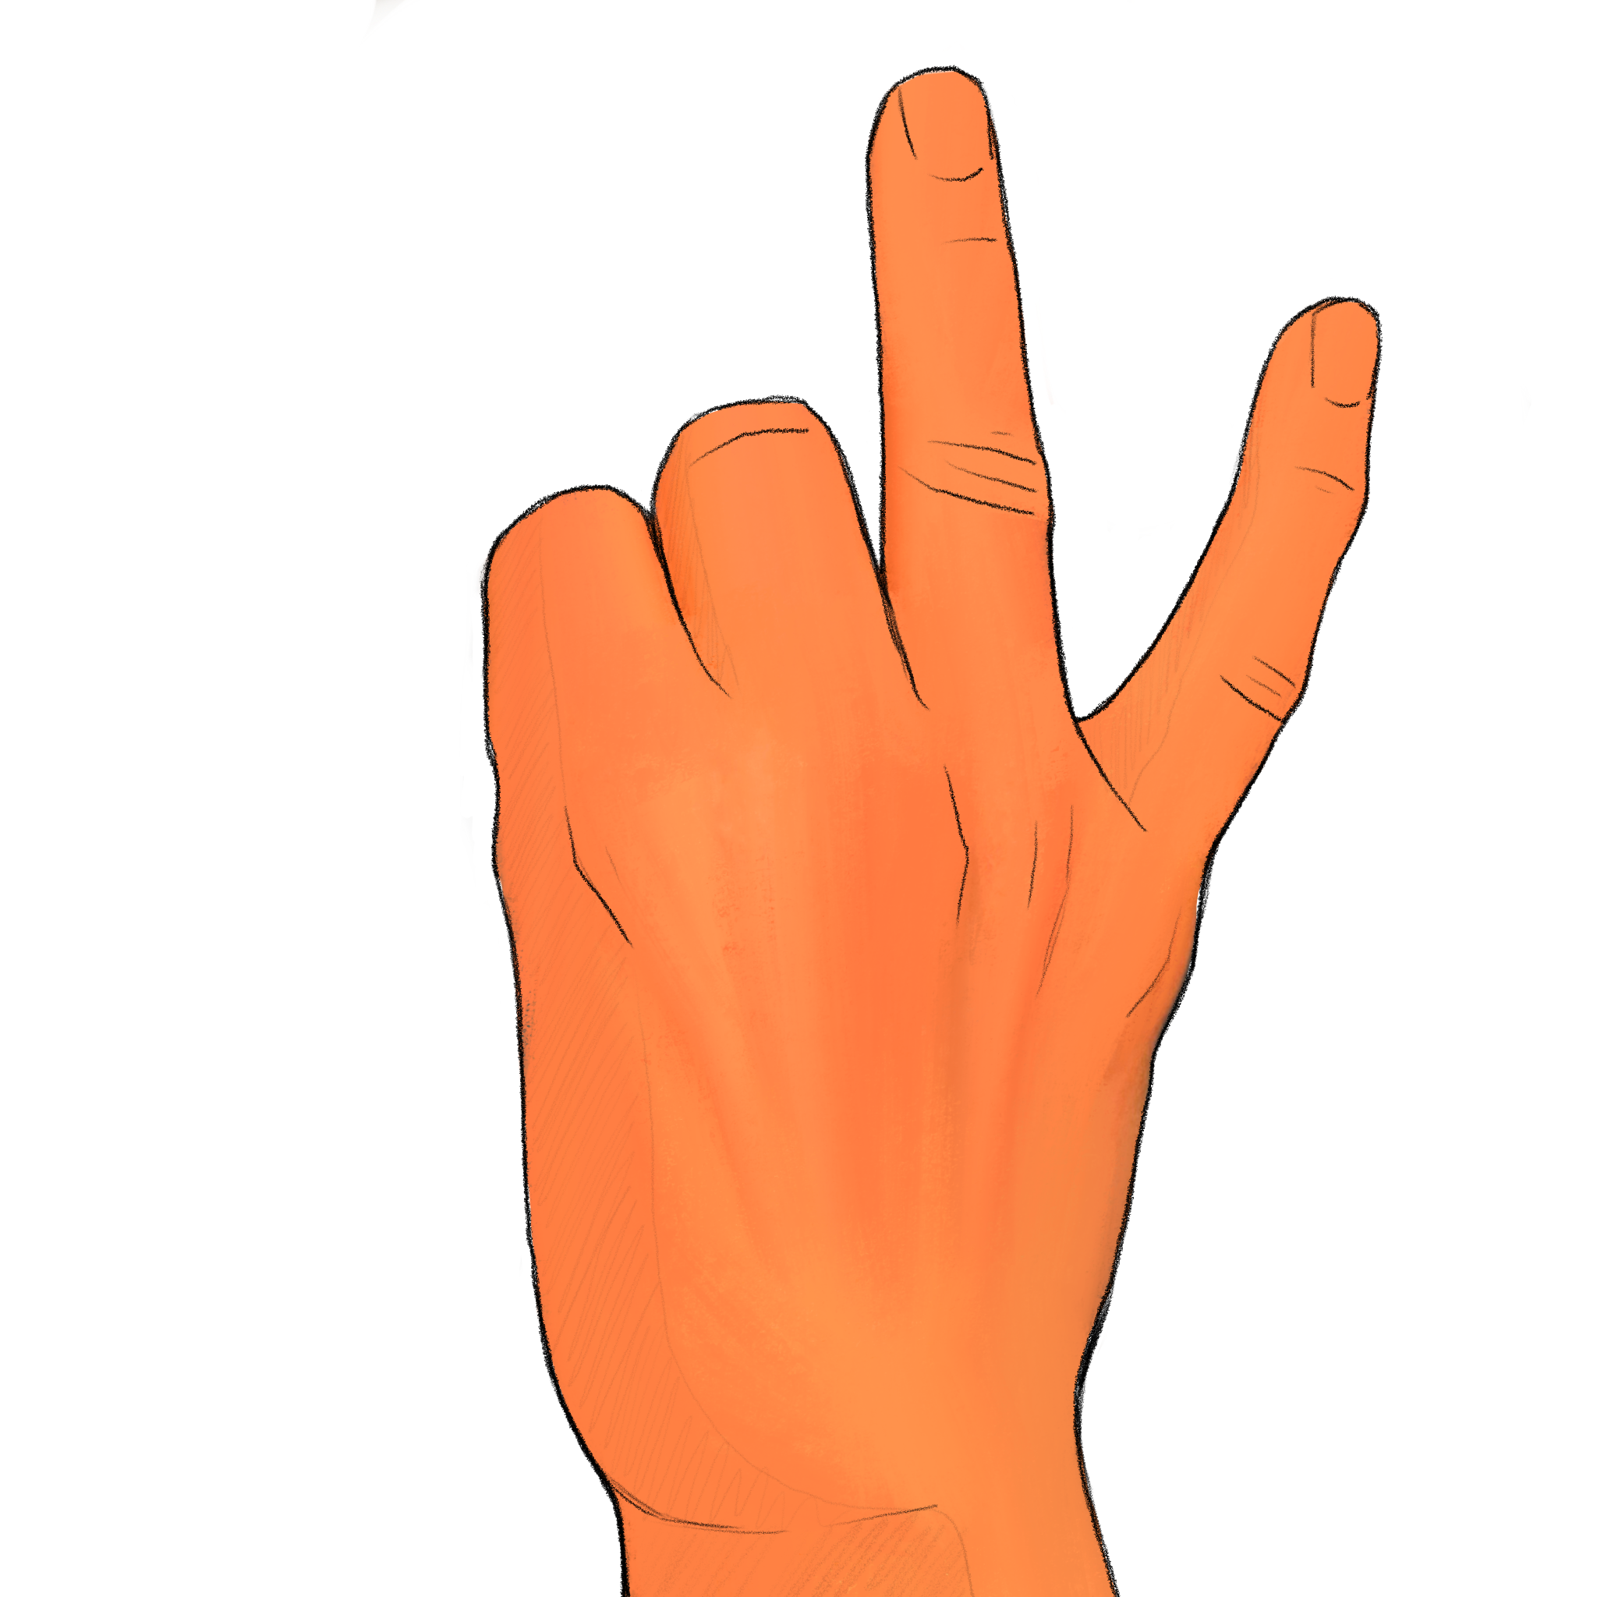
+

Slide 54
How many digits were raised? Experimenter, record the participant’s response if given before next slide transition; otherwise record a ’timeout’

Slide 55
Trial 14 Press any key to continue.

Slide 56
+

Slide 57
+

Slide 58
How many digits were raised? Experimenter, record the participant’s response if given before next slide transition; otherwise record a ’timeout’

Slide 59
Trial 15 Press any key to continue.

Slide 60
+

Slide 61
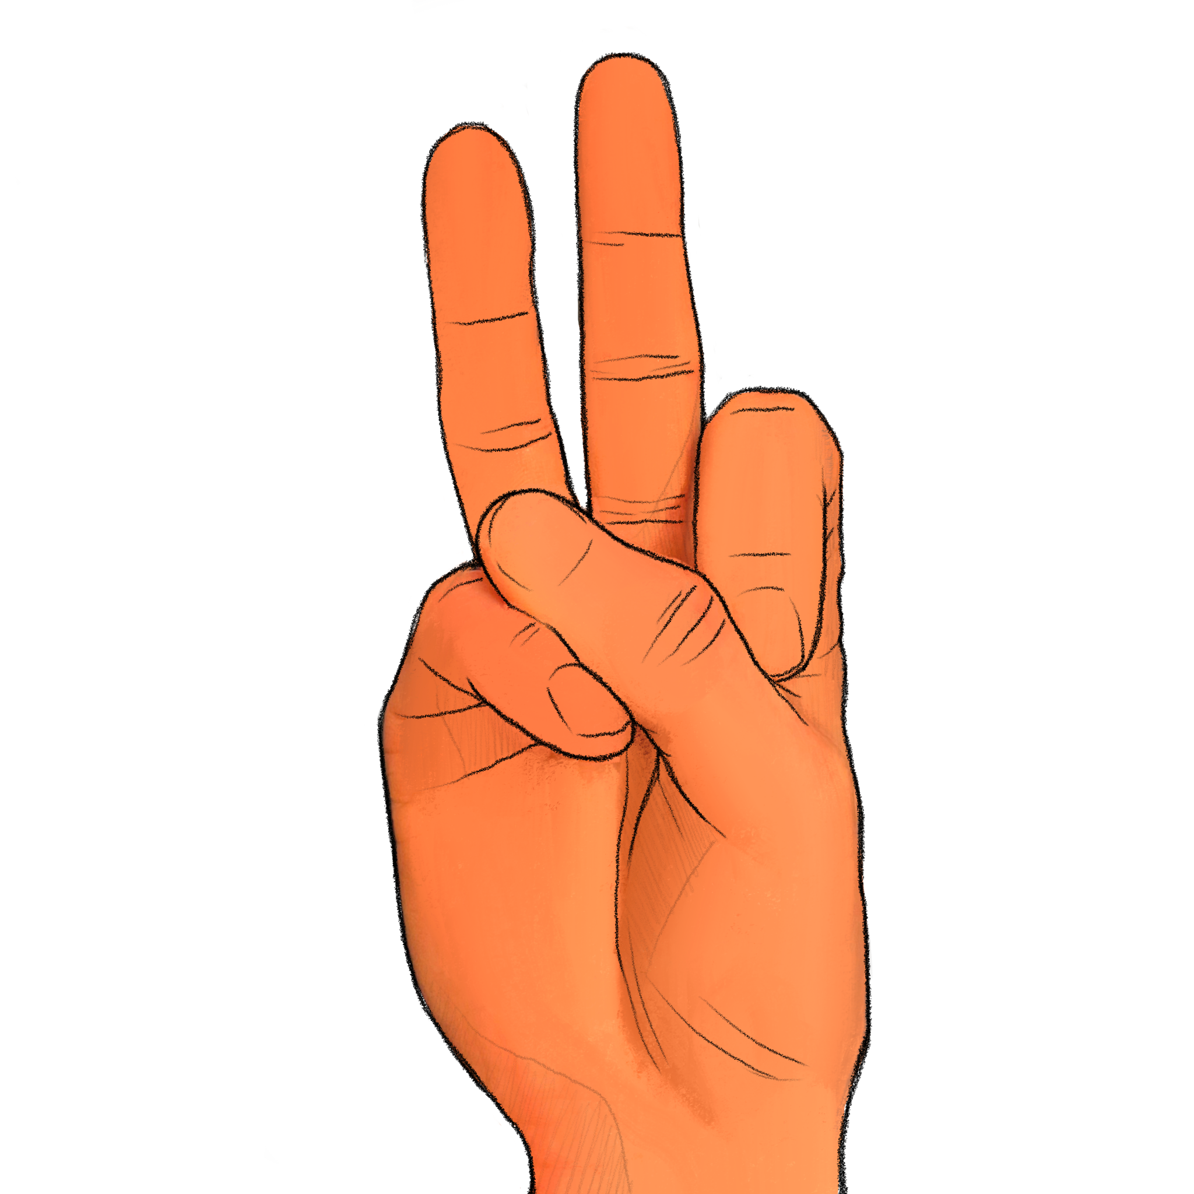
+

Slide 62
How many digits were raised? Experimenter, record the participant’s response if given before next slide transition; otherwise record a ’timeout’

Slide 63
Trial 16 Press any key to continue.

Slide 64
+

Slide 65
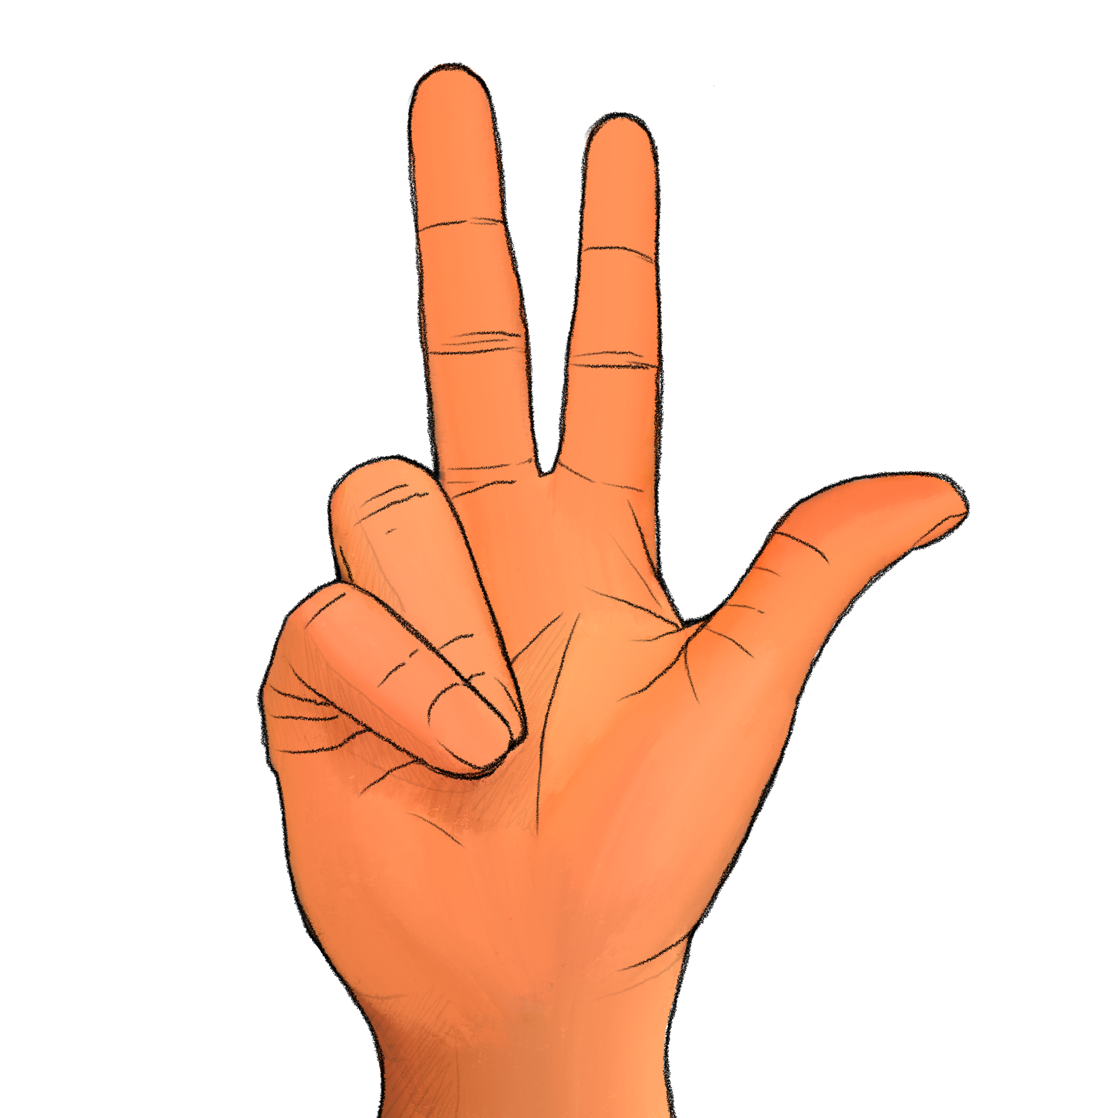
+

Slide 66
How many digits were raised? Experimenter, record the participant’s response if given before next slide transition; otherwise record a ’timeout’

Slide 67
Trial 17 Press any key to continue.

Slide 68
+

Slide 69
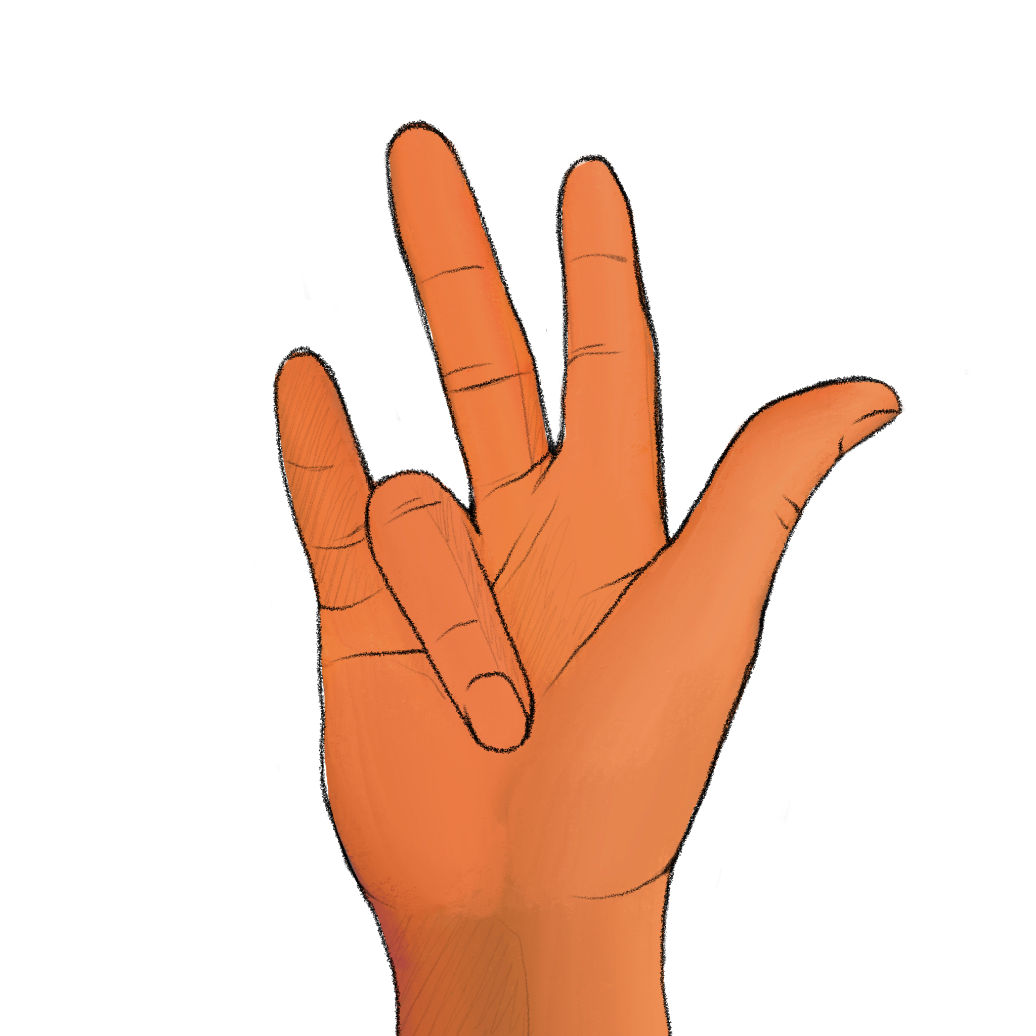
+

Slide 70
How many digits were raised? Experimenter, record the participant’s response if given before next slide transition; otherwise record a ’timeout’

Slide 71
Trial 18 Press any key to continue.

Slide 72
+

Slide 73
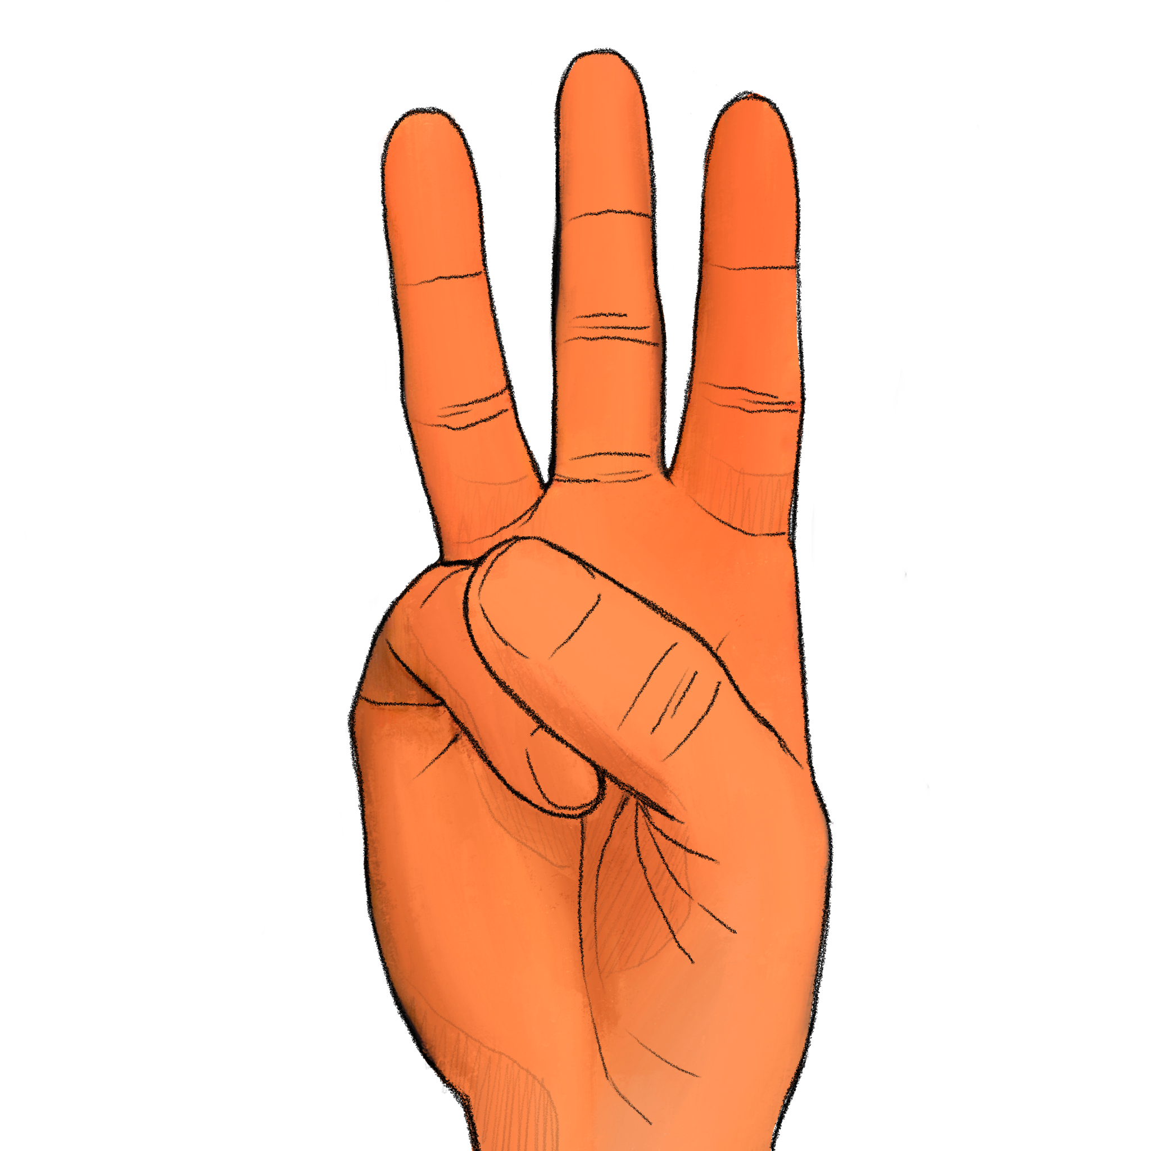
+

Slide 74
How many digits were raised? Experimenter, record the participant’s response if given before next slide transition; otherwise record a ’timeout’

Slide 75
Trial 19 Press any key to continue.

Slide 76
+

Slide 77
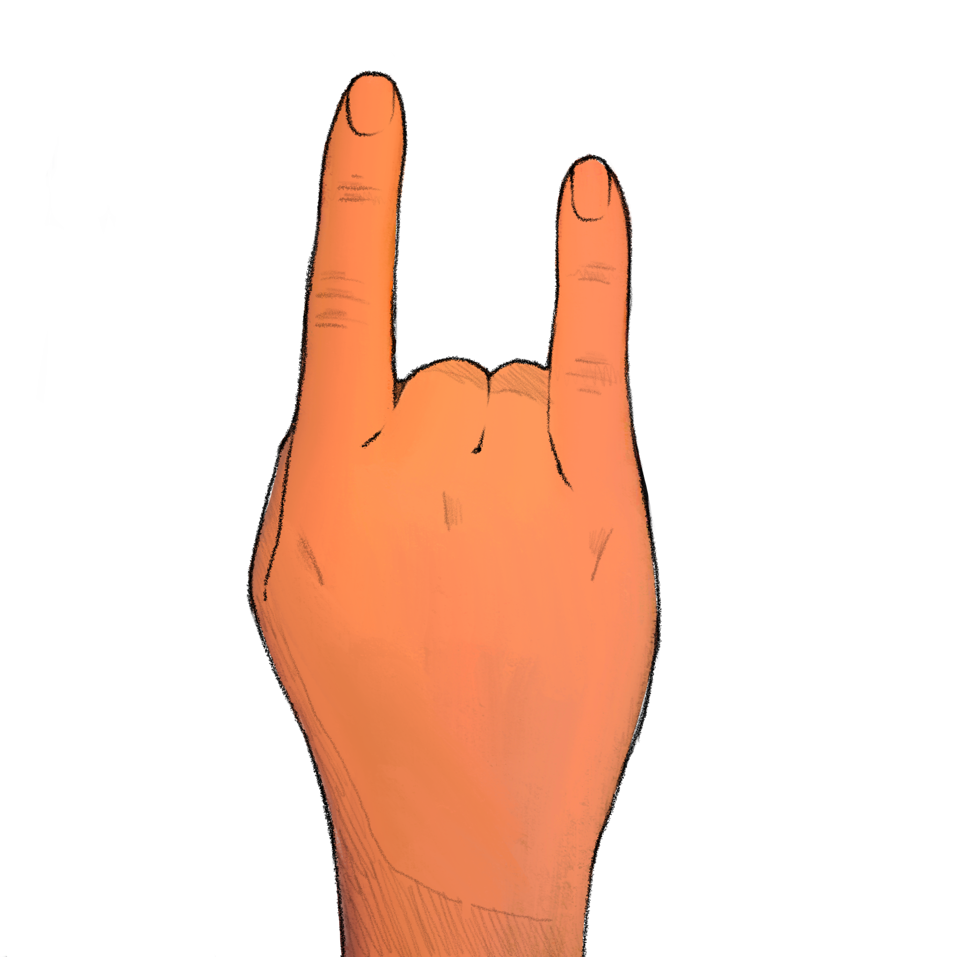
+

Slide 78
How many digits were raised? Experimenter, record the participant’s response if given before next slide transition; otherwise record a ’timeout’

Slide 79
Trial 20 Press any key to continue.

Slide 80
+

Slide 81



